Slide 1
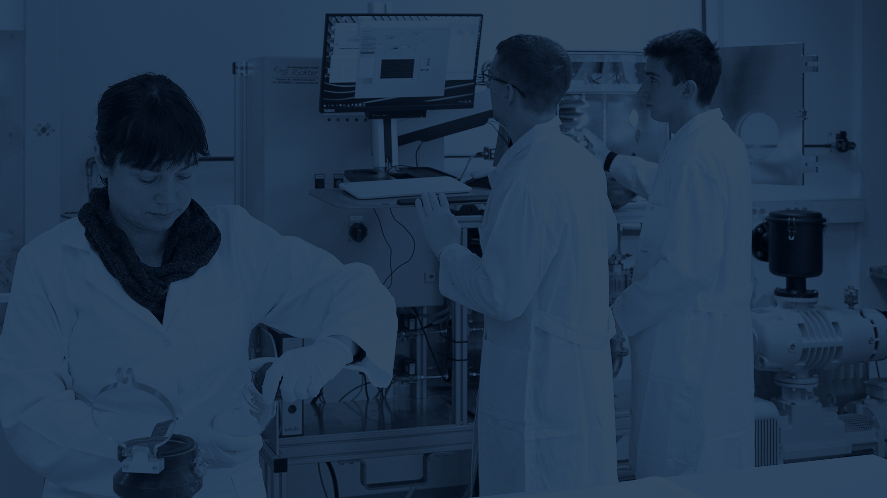

Jožef Stefan Institute (JSI)

Slide 2

Mission statement
The JSI's mission is to collect, create and disseminate knowledge at the highest level of natural and technical sciences for the well-being of Slovenian society and humanity in general. With the constant development of new knowledge, the JSI provides the best education to personnel as well as the research and development of technologies at the highest international level of excellence.
The mission of JSI is realized through:
a professional attitude to research at the cutting edge of science at all levels;
education that is embedded in research and development; in doing so, the JSI cooperates closely with other institutions in Slovenia and around the world;
focusing on new research topics, which are frequently interdisciplinary;
the transfer of technologies and exchange personnel to industry;
raising public awareness, especially among young people, of the growing importance of science and technology;
environmental and public-safety services;
adopting flexible, goal-oriented organizational structures that can respond quickly to new challenges and offer the appropriate services.

Slide 3
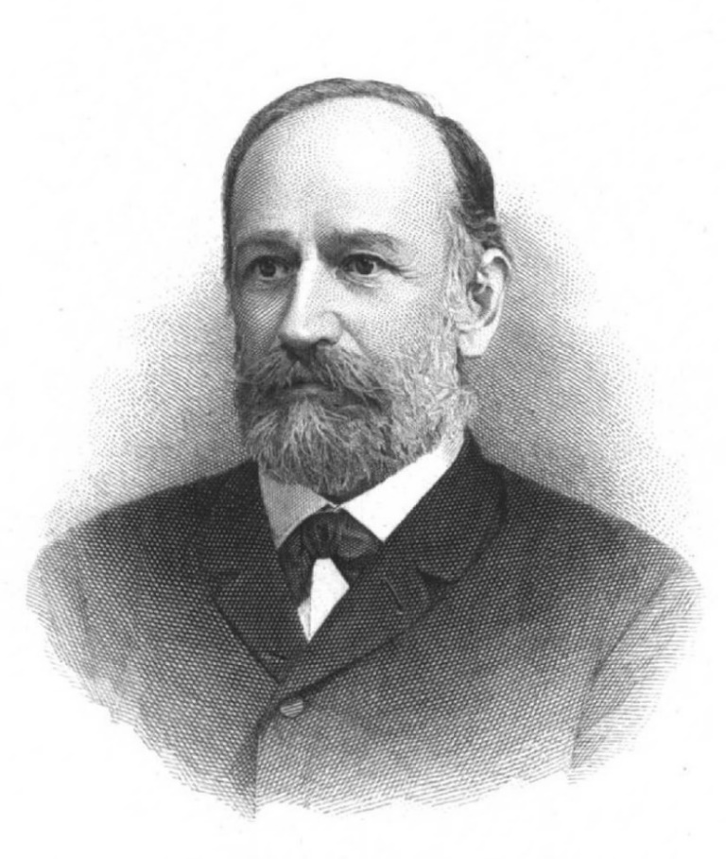
Name of the Institute
Jožef Stefan: distinguished 19th century physicist, most famous for his work on the Stefan-Boltzmann law of black-body radiation
Jožef Stefan
1835–1893

Slide 4
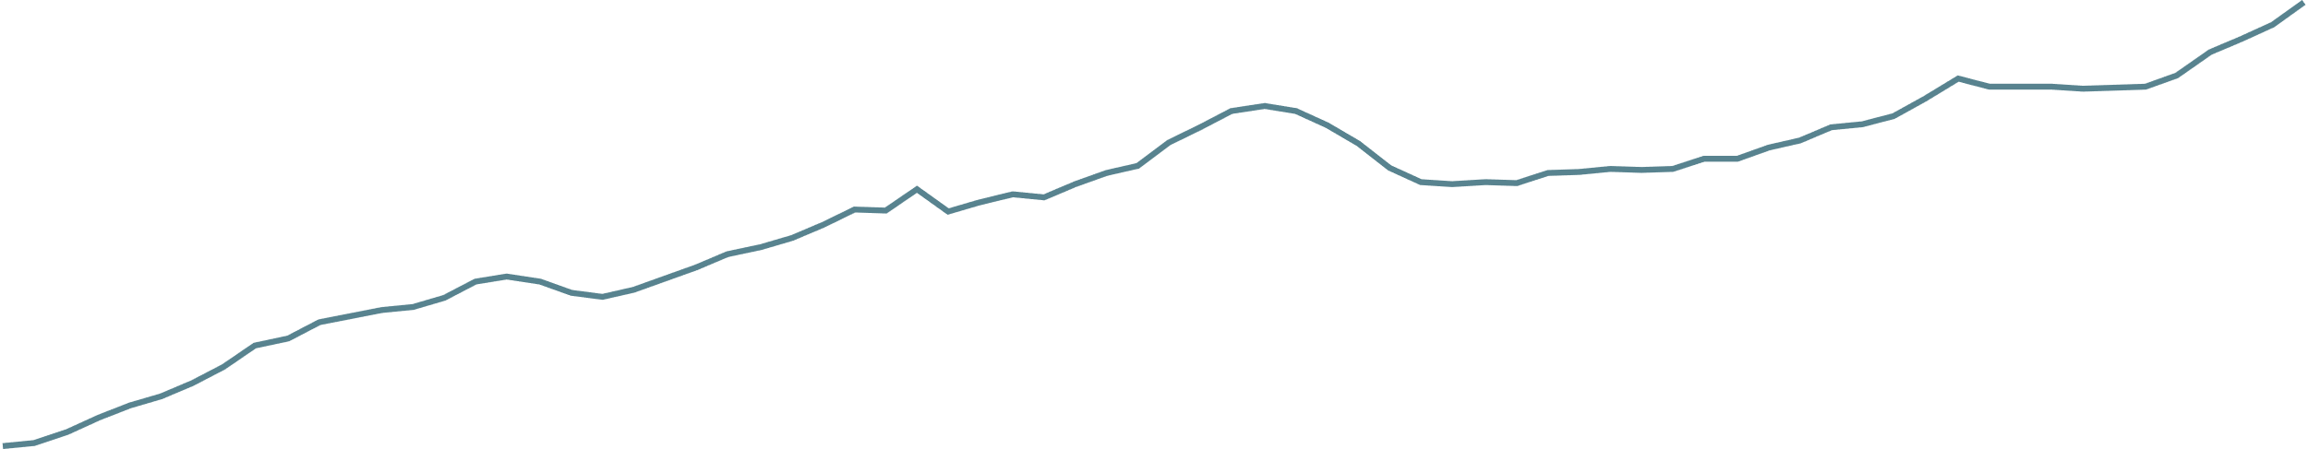
History
Institute milestones and growth in the number of employees
7
335
443
420
749
809
770
961
1087
1263
1946
1959
1966
1969
“Jožef Stefan”
Institute
1985
1992
2004
2012
2020
2024
Establishment of the Physics Institute
Jožef Stefan
Nuclear Institute
Project for 2000 new researchers
Technology Park JSI
Jožef Stefan International Postgraduate School
TRIGA
Reactor
1st ERC project
International Research Centre on Artificial Intelligence (UNESCO)
10th ERC project,
Katana,
project
Squash

Slide 5
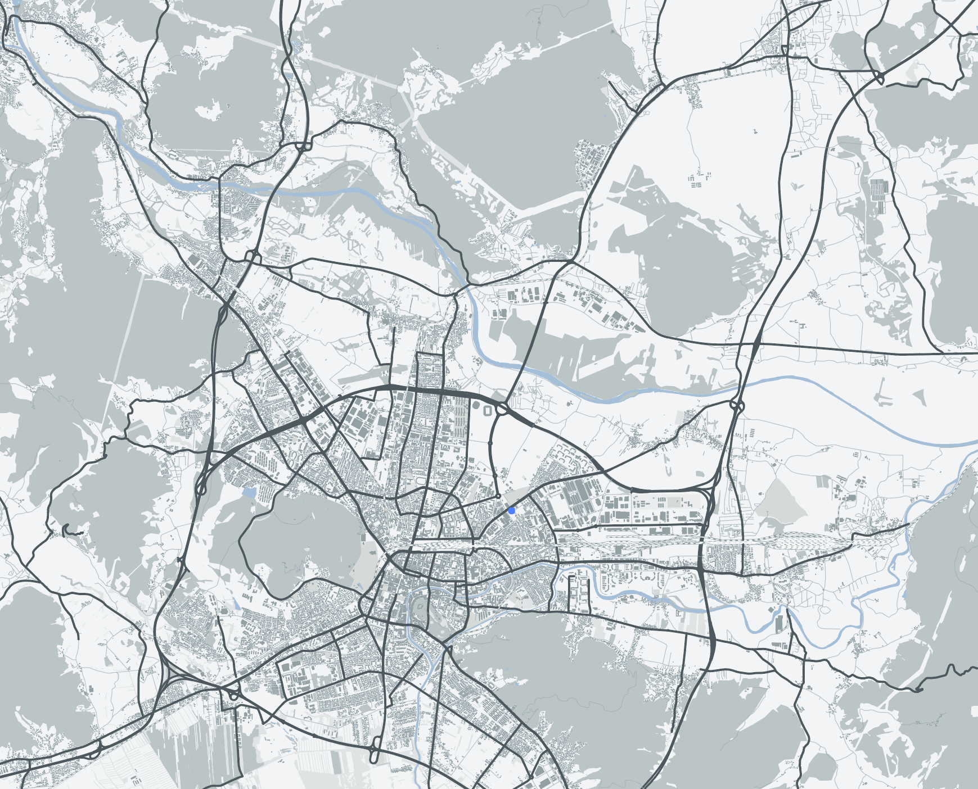
Location
Domžale
6
Locations and
numbers of
employees
186
Brinje
939
Jamova cesta
Tržaška cesta
99
Teslova ulica
39
Data as of 31.12.2024

Slide 6

The Institute in numbers
1263
employees*
838
researchers*
223
faculty members lecturing at ->
49
various higher-education institutions**
835
young researchers * * *
903
doctoral theses***
1060+
published articles**
60,751
citations*
769
projects**
13
ERC projects
124
awards***
46
programmes**
78,053
€m of planned revenue*
2894
media releases**
21,700+
visitors**
*Data collected on 31.12.2024
**Data are for 2024
***Data for 2000-2024

Slide 7

Staff
Total
1263
employees
Number of employees by gender and area of activity
39 %
female
34 %
support staff
61 %
male
66 %
researchers
Data collected on 31.12.2024

Slide 8

Staff
Total
838
researchers
Number of researchers by country of origin
23 %
international staff from
47
different countries
77 %
local staff
Data collected on 31.12.2024

Slide 9

Main areas of research
JSI departments divided into areas
Electronics and Information Technologies
Physics, nuclear engineering and energy
Chemistry, biochemistry, materials and environment
Automation, biocybernetics and robotics
Systems and control
Artificial intelligence
Open systems and networks
Communication systems
Computer systems
Knowledge technologies
Intelligent systems
Theoretical physics
Low and medium energy physics
Thin films and surfaces
Surface technology
Solid State Physics
Gas electronics
Complex matter
Reactor physics
Experimental particle physics
Reactor technology
Biochemistry, molecular and structural biology
Molecular and Biomedical Sciences
Biotechnology
Inorganic chemistry and technology
Physical and organic chemistry
Electronic ceramics
Nanostructured materials
Synthesis of materials
Advanced materials
Environmental sciences
8
depart-
ments
10
depart-
ments
10
depart-
ments

Slide 10

Main areas of research
Total
838
researchers
Number of researchers by scientific fields
(27 female researchers and 36 researchers are employed in centres and technical services)
Electronics and Information Technologies
Physics, nuclear engineering and energy
Chemistry, biochemistry, materials and environment
168
49
265
78
129
149
male
female
male
female
male
female
Data collected on 31.12.2024

Slide 11


Publication of JSI articles in top scientific journals
Total
1343
publications
Elsevier CiteScore
69 %
40 %
17 %
3 %
articles in
the top 25% of scientific journals.
articles in
the top 10% of scientific journals.
articles in
the top 5% of scientific journals.
articles in
the top 1% of scientific journals.
Data are for 2024, data acquisition 2025, source: SciVal

Slide 12


Publication of JSI articles in top scientific journals
Total
60,751
citations
Total
1069
publications
Web of Science
»
»
60,751
649,667
1069
citations of all JSI articles
citations of all JSI articles
Number of published JSI articles
Data are for 2024
Data are for 2000–2024
Data are for 2024

Slide 13

Projects
Total
769
projects
Number of all projects in 2024
295
160
157
157
projects financed by the national agency: ARIS
projects financed by different European Union schemes
market projects:
domestic
market projects:
international
Data are for 2024

Slide 14

The Institute and the European Research Council (ERC)
Total
13
ERC projects
The JSI is proud of all its ERC project grantees
2012
D. Mihailović ERC-2012-AdG TRAJECTORY
D. Mihailović ERC-2017-PoC Umem4QC
M. Humar ERC-2019-StG Cell-Lasers P. Križan ERC-2019-AdG FAIME I. Muševič ERC-2019-AdG LOGOS
M. Lozinšek ERC-2020-StG HiPeR-F
P. Križan ERC-2022-PoC CherPET Z. Lenarčič ERC-2022-StG DrumS
L. Vidmar ERC-2023-CoG Boundary D. Mihailović ERC-2023-AdG HIMMS
Matjaž Humar ERC-2024-POC EdibleLasers Matjaž Humar ERC-2024-CoG SoftQuanta Andrii Tykhonov ERC-2024-CoG PeVGALAXY
2017
2019
2020
2022
2023
2024
161
251
Notes:
V letu 2025 bodo trenutno še: - EdibleLasers (F5), SoftQuanta (F5) in PeVGALAXY (F9).

Slide 15

Programmes
Total
46
programmes
Number of programmes by policy area in 2024
Electronics and Information Technologies
Physics, nuclear engineering and energy
Chemistry, biochemistry, materials and environment
11
JSI coordinators
35
JSI participants
7
1
17
5
11
5
Data are for 2024

Slide 16
Programme revenues
Total
21.256
€ m
Revenues from programmes by topic in 2024
Electronics and Information Technologies
Physics, nuclear engineering and energy
Chemistry, biochemistry, materials and environment
1865
€ m
JSI coordinator
19.391
€ m
IJS partners
3,411
0,434
8,921
0,572
7,059
0,859
Data are for 2024

Slide 17
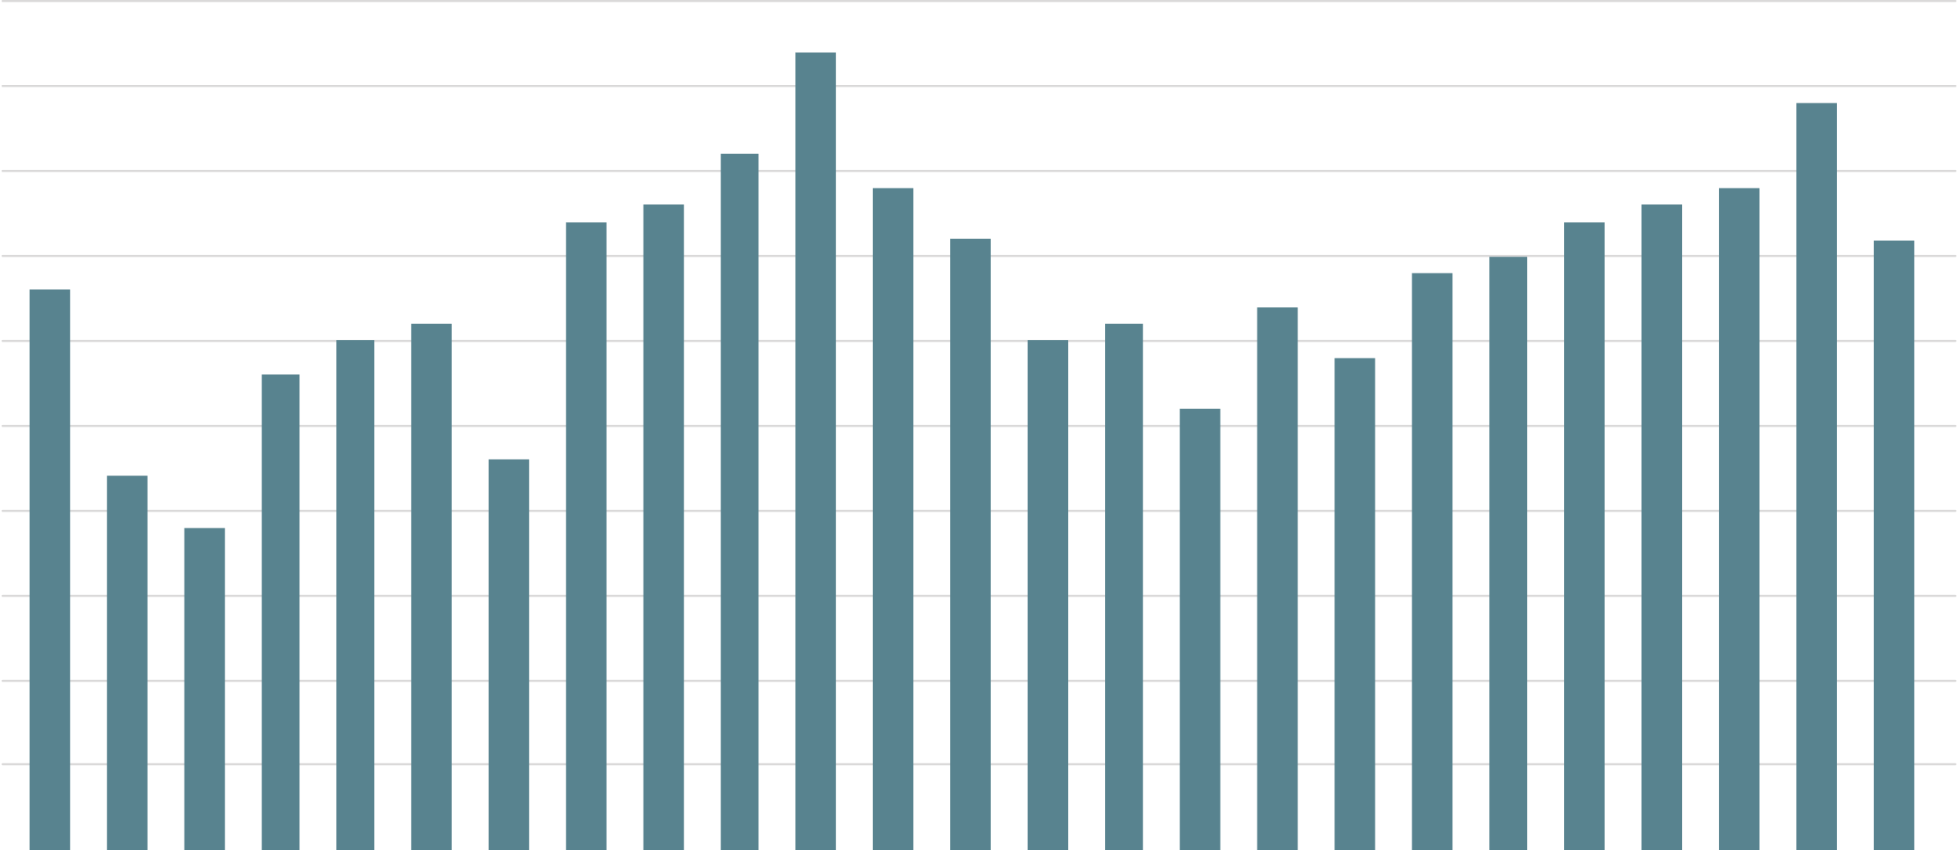
Young researchers
Total
835
young researchers
Number of young researchers covered by ARRS funding in the period 2000–2024 by year
50
40
30
20
10
2000
2005
2010
2015
2020
Data are for the period 2000–2024

Slide 18

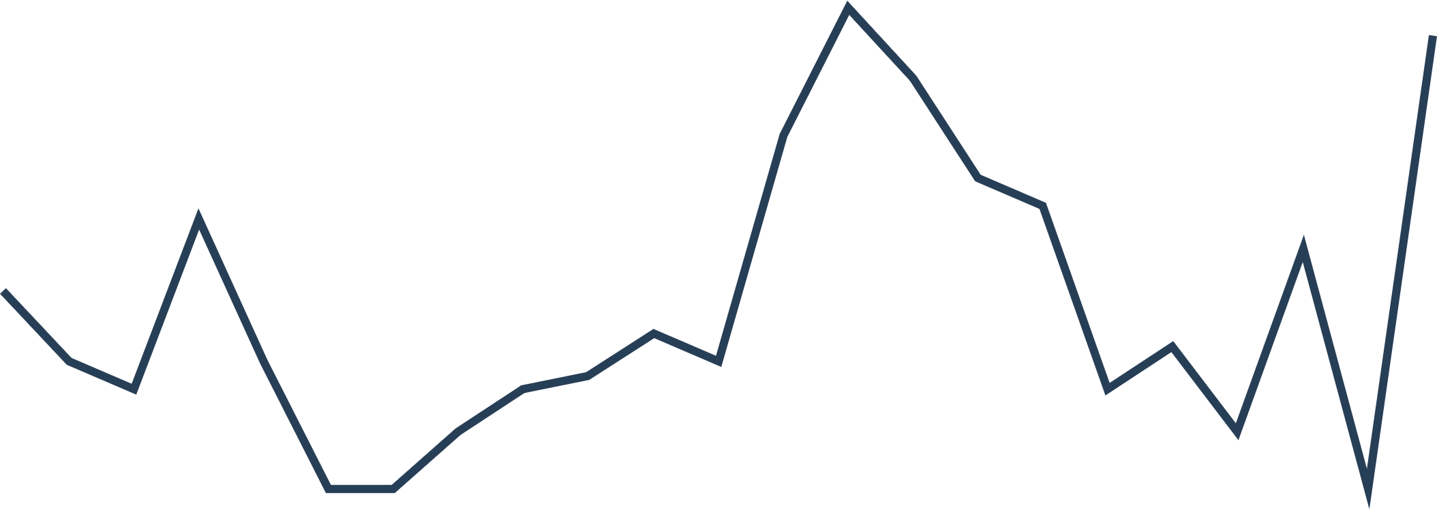
Doctoral theses
Total
903
Doctoral theses
Number of doctorates with mentors from the JSI
60
50
40
30
20
10
2000
2005
2010
2015
2020
2025
The data of the number of doctorates in the year with mentors from the JSI for the period 2000-2024

Slide 19

Awards
Total
124
awards
Number of Zois, Puh Awards and Ambassadors of Science
49
Zois prizes
5
Ambassadors of science
38
Zois awards
27
Puh
prizes
5
Puh
awards
Data are for the period 2000–2024

Slide 20


Comparison with the rest of the world
Jožef Stefan Institute (JSI) // Max Planck Institute (MPS) // French National Centre for Scientific Research (CNRS)
 |  | population | Number of employees | Number of employees as % of population
JSI | Slovenia | 2.12 m | 1,263 | 0.06 %
MPS | Germany | 84.55 m | 24,650 | 0.03 %
CNRS | France | 66.55 m | 33,000 | 0.05 %
Employees
Le |  | Annual revenue | Annual income per employee
JSI | Slovenia | 65 € m | 53,400 €
MPS | Germany | 2,300 € m | 93,300 €
CNRS | France | 4,000 € m | 121,200 €
Revenue
Data are for period 2022-2024

Slide 21
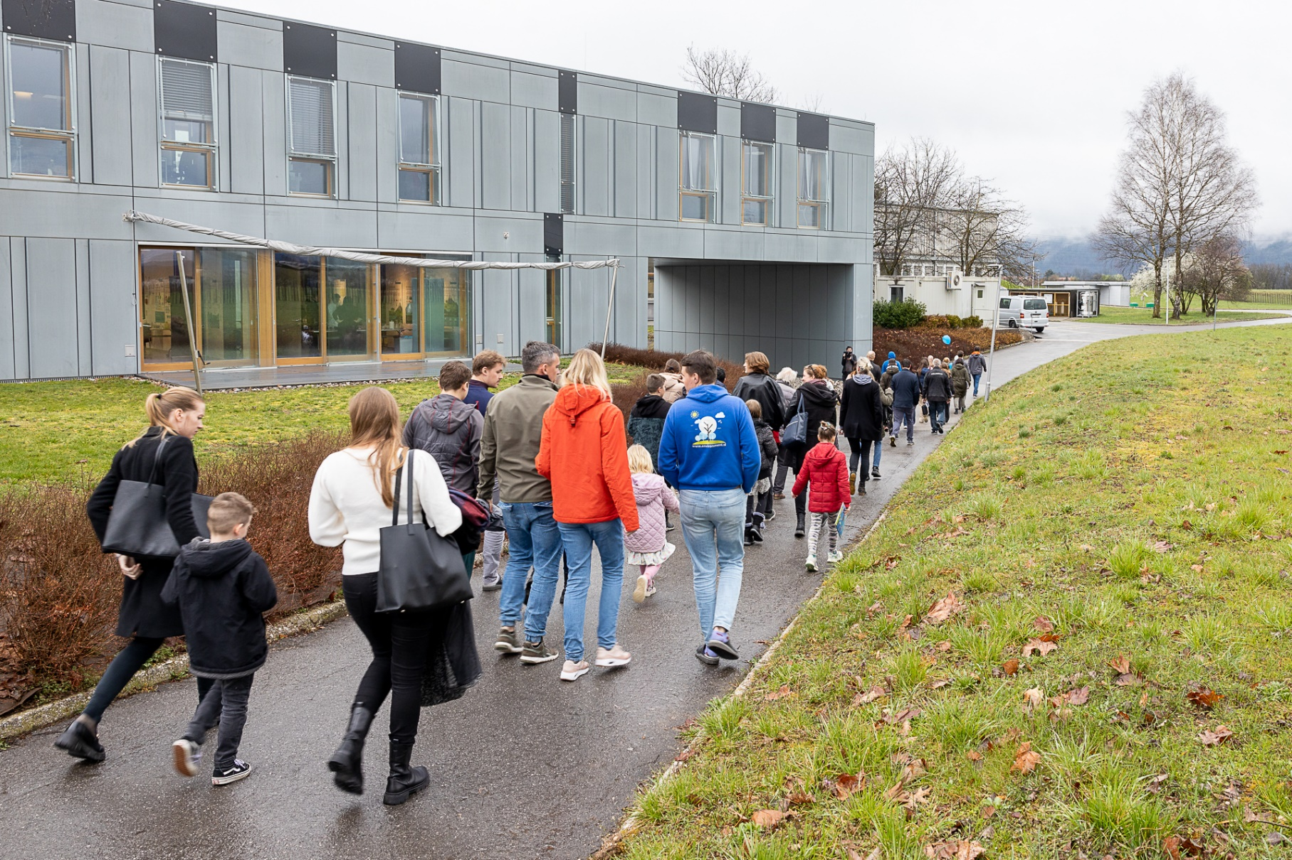
Public cooperation
Total of more than
21,700+
visitors
Number of visitors to JSI events organised for different groups and number of visitors to the Nuclear Technology Training Centre
Events
1,200
9,450
1,070
1,000
2,000
Colloquia
Gallery
School visits
Days of Jožef Stefan
Open Day
Nuclear Technology Training Centre
7,020
Data are for 2024
Notes:
ICJT je rešeno

Slide 22
Appearances in the media
Total
2811
media releases
Incidences of the Jožef Stefan Institute and the
Director Prof. Dr. Boštjan Zalar appearing in print and online media
23 %
posts in
print media
Media that wrote the most on these topics:
Authors who wrote the most on these topics:
77 %
publications in online media
novice.najdi.si
sta.si
Delo
Megafon.si
rtvslo.si
STA
Saša Senica
Marko Medvešček
Branko Janjič
G. C.
Data are for 2024

Slide 23
Thank you for your attention
Jožef Stefan Institute
Jamova cesta 39
1000 Ljubljana
Slovenija
https://www.ijs.si/

