Slide 1
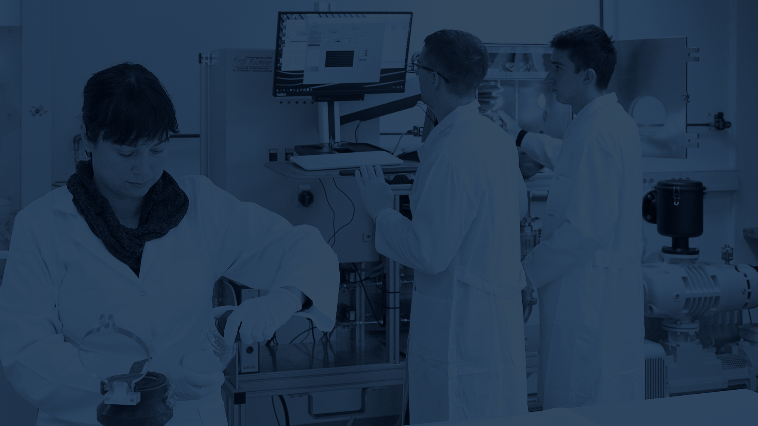

Jožef Stefan Institute (JSI)
Notes:
Last update: 14.2.2023
You can get used font here: https://fonts.google.com/specimen/Titillium+Web

Slide 2

Mission statement
The JSI's mission is to collect, create and disseminate knowledge at the highest level of natural and technical sciences for the well-being of Slovenian society and humanity in general. With the constant development of new knowledge, the JSI provides the best education to personnel as well as the research and development of technologies at the highest international level of excellence.
The mission of JSI is realized through:
a professional attitude to research at the cutting edge of science at all levels;
education that is embedded in research and development; in doing so, the JSI cooperates closely with other institutions in Slovenia and around the world;
focusing on new research topics, which are frequently interdisciplinary;
the transfer of technologies and personnel to industry;
raising public awareness, especially among young people, of the growing importance of science and technology;
environmental and public-safety services;
adopting flexible, goal-oriented organizational structures that can respond quickly to new challenges and offer the appropriate services.

Slide 3
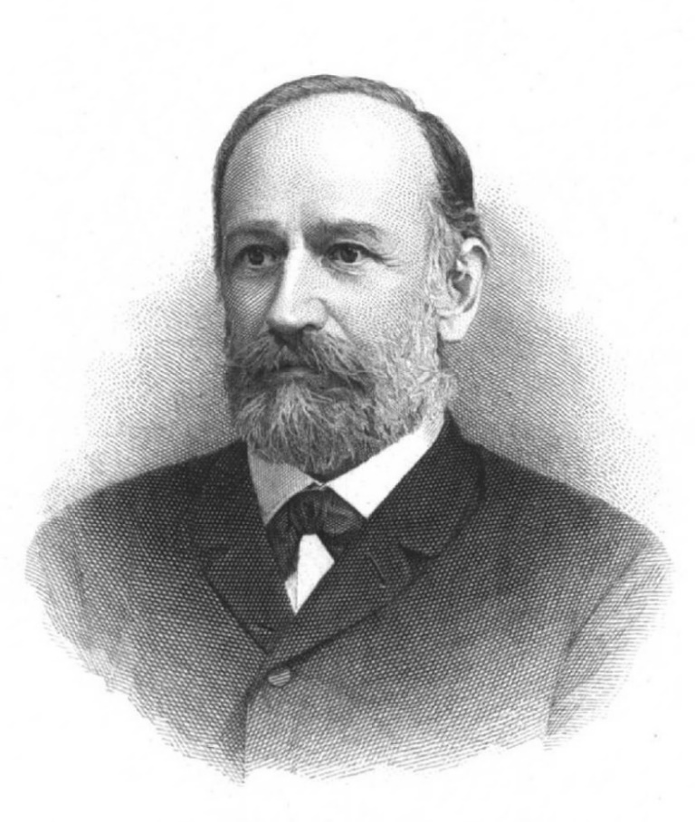
Name of the Institute
Jožef Stefan: distinguished 19th century physicist, most famous for his work on the Stefan-Boltzmann law of black-body radiation
Jožef Stefan
1835–1893

Slide 4
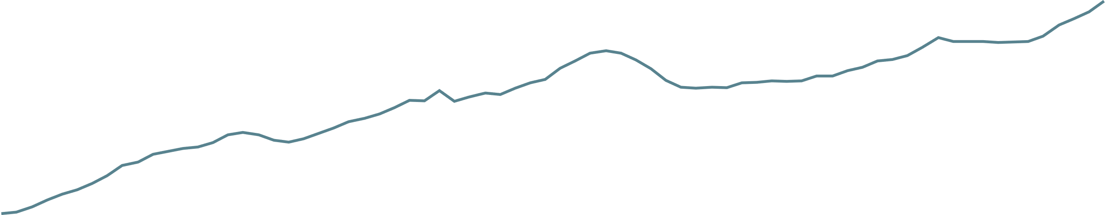
History
Institute milestones and growth in the number of employees
7
335
443
420
749
809
770
961
1087
1946
1959
1966
1969
“Jožef Stefan”
Institute
1985
1992
2004
2012
2020
Establishment of the Physics Institute
Jožef Stefan“
Nuclear Institute
Technology Park JSI
Jožef Stefan International Postgraduate School
TRIGA
Reactor
Project for 2000 new researchers
First ERC project
International Research Centre on Artificial Intelligence (UNESCO)

Slide 5
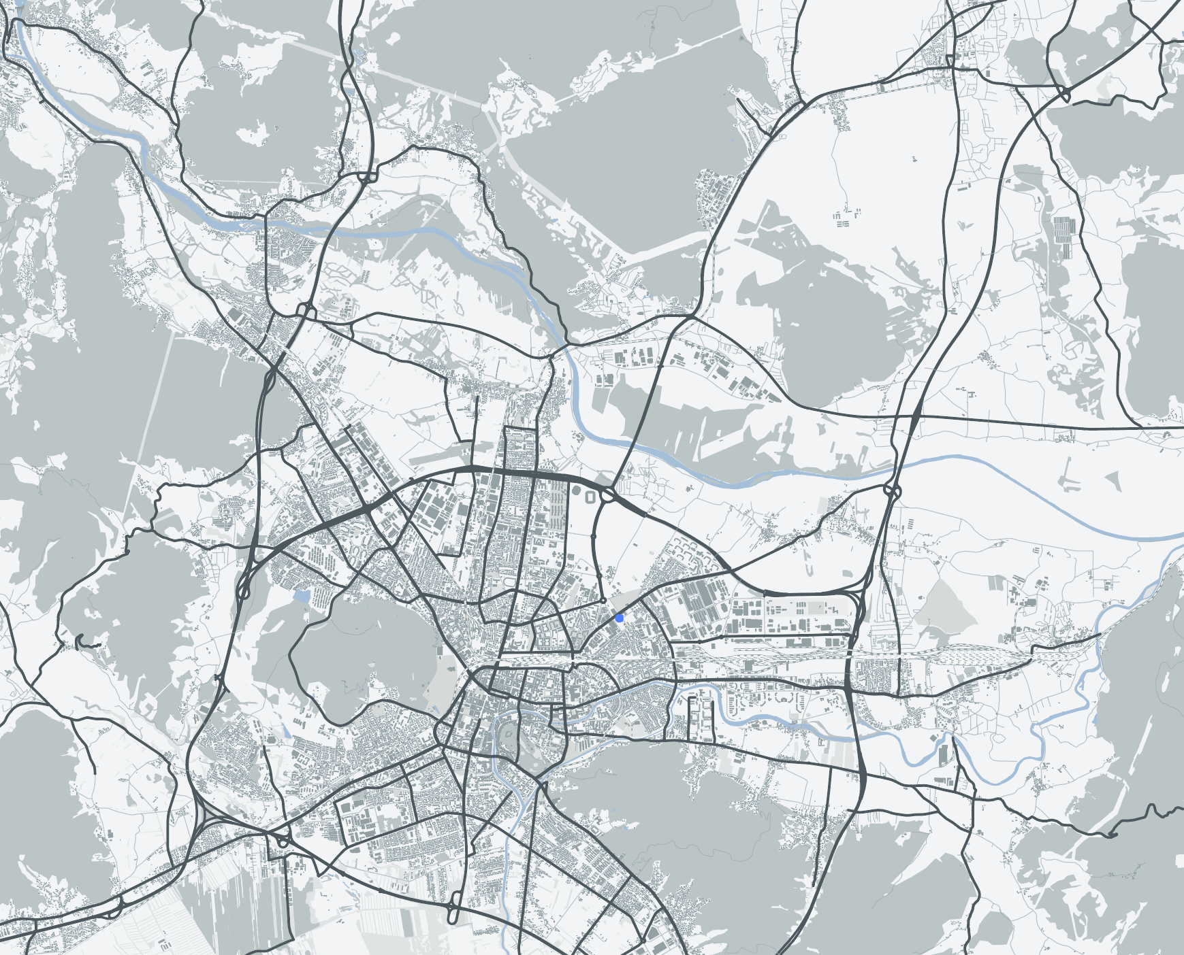
Location
Domžale
6
Locations and
numbers of
employees
183
Brinje
910
Jamova cesta
Tržaška cesta
84
Teslova ulica
35
Data as of 31.12. 2023

Slide 6

The Institute in numbers
1218
employees*
831
researchers*
224
faculty members lecturing at ->
49
various higher-education institutions**
799
young researchers * * *
803
doctoral theses***
900+
published articles**
42,477
citations*
770
projects**
9
ERC projects
122
awards***
46
programmes**
78,053
€m of planned revenue*
2811
media releases**
20,600+
visitors**
*Data collected on 31.12.2023
**Data are for 2023
***Data for 2000-2023

Slide 7

Staff
Total
1218
employees
Number of employees by gender and area of activity
32 %
support staff
39 %
female
61 %
male
68 %
researchers
Data collected on 31.12.2023

Slide 8

Staff
Total
831
researchers
Number of researchers by country of origin
15 %
international staff from
42
different countries
85 %
local staff
Data collected on 31.12.2023

Slide 9

Main areas of research
JSI departments divided into areas
Electronics and Information Technologies
Physics, nuclear engineering and energy
Chemistry, biochemistry, materials and environment
Automation, biocybernetics and robotics
Systems and control
Artificial intelligence
Open systems and networks
Communication systems
Computer systems
Knowledge technologies
Intelligent systems
Theoretical physics
Low and medium energy physics
Thin films and surfaces
Surface technology
Solid State Physics
Gas electronics
Complex matter
Reactor physics
Experimental particle physics
Reactor technology
Biochemistry, molecular and structural biology
Molecular and Biomedical Sciences
Biotechnology
Inorganic chemistry and technology
Physical and organic chemistry
Electronic ceramics
Nanostructured materials
Synthesis of materials
Advanced materials
Environmental sciences
8
depart-
ments
10
depart-
ments
10
depart-
ments

Slide 10

Main areas of research
Total
806
researchers
Number of researchers by scientific fields
(7 female researchers and 18 researchers are employed in centres and technical services)
Electronics and Information Technologies
Physics, nuclear engineering and energy
Chemistry, biochemistry, materials and environment
155
42
260
77
126
146
male
female
male
female
male
female
Data collected on 31.12.2023

Slide 11


Publication of JSI articles in top scientific journals
Total
1212
publications
Elsevier CiteScore
68 %
40 %
20 %
3 %
articles in
the top 25% of scientific journals.
articles in
the top 10% of scientific journals.
articles in
the top 5% of scientific journals.
articles in
the top 1% of scientific journals.
Data are for 2023, data acquisition 18.01.2024, source: SciVal

Slide 12


Publication of JSI articles in top scientific journals
Total
42,477
citations
Total
909
publications
Web of Science
»
»
42,477
572,706
909
citations of all JSI articles
citations of all JSI articles
Number of published JSI articles
Data are for 2023
Data are for 2000–2023
Data are for 2023

Slide 13

Projects
Total
770
projects
Number of all projects in 2023
333
147
158
132
projects financed by the national agency: ARIS
projects financed by different European Union schemes
market projects:
domestic
market projects:
international
Data are for 2023

Slide 14

The Institute and the European Research Council (ERC)
Total
9
ERC projects
The JSI is proud of all its ERC project grantees
2012
D. Mihailović ERC-2012-AdG TRAJECTORY
D. Mihailović ERC-2017-PoC Umem4QC
M. Humar ERC-2019-StG CELL-Lasers
P. Križan ERC-2019-AdG FAIME
I. Muševič ERC-2019-AdG LOGOS
M. Lozinšek ERC-2020-StG HiPeR-F
P. Križan ERC-2022-PoC CherPET
Z. Lenarčič ERC-2022-StG DrumS
L. Vidmar ERC-2023-CoG Boundary
2017
2019
2022
2023
161
251

Slide 15

Programmes
Total
46
programmes
Number of programmes by policy area in 2023
Electronics and Information Technologies
Physics, nuclear engineering and energy
Chemistry, biochemistry, materials and environment
11
JSI coordinators
35
JSI participants
7
1
17
5
11
5
Data are for 2023

Slide 16
Programme revenues
Total
19.059
€ m
Revenues from programmes by topic in 2023
Electronics and Information Technologies
Physics, nuclear engineering and energy
Chemistry, biochemistry, materials and environment
1460
€ m
JSI coordinator
17.599
€ m
IJS partners
3,167
0,267
7,938
0,396
6,494
0,796
Data are for 2023

Slide 17


Total
244
faculty members lecturing at ->
Total
49
higher-education institutions
Education
Number of all staff teaching at different higher-education institutions.
55
189
35
14
supplementary staff
regular staff working with higher-education institutions
number of Slovenian higher-education institutions involved
number of foreign higher-education institutions involved
161
251
Data are for 2022

Slide 18
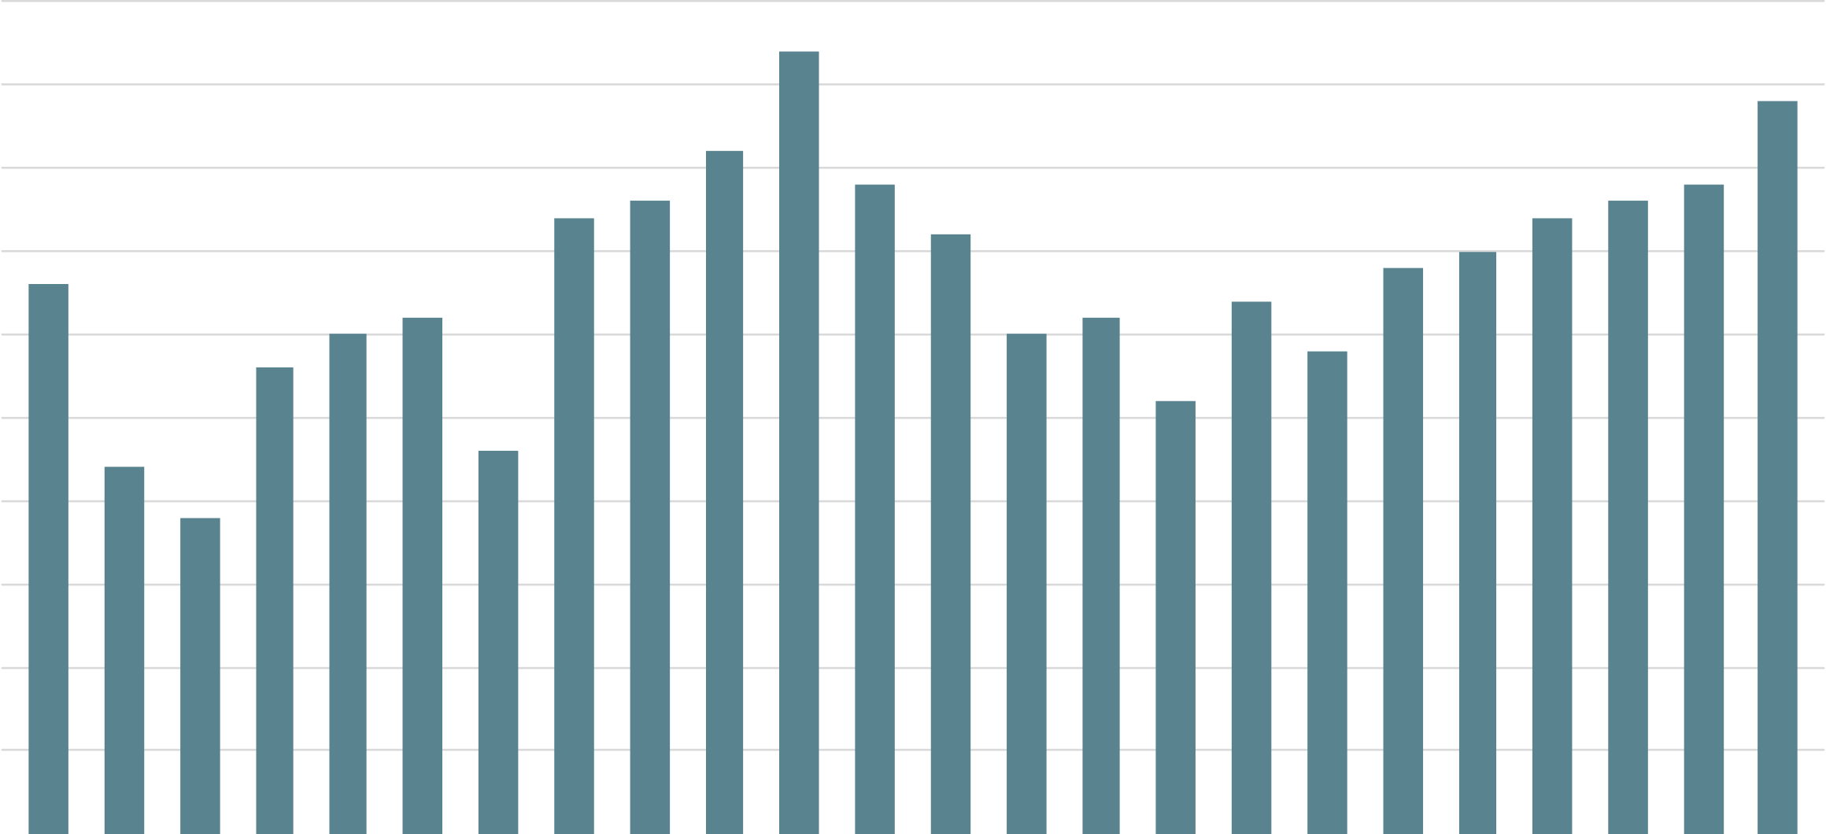
Young researchers
Total
799
young researchers
Number of young researchers covered by ARRS funding in the period 2000–2023 by year
50
40
30
20
10
2000
2005
2010
2015
2020
Data are for the period 2000–2023

Slide 19
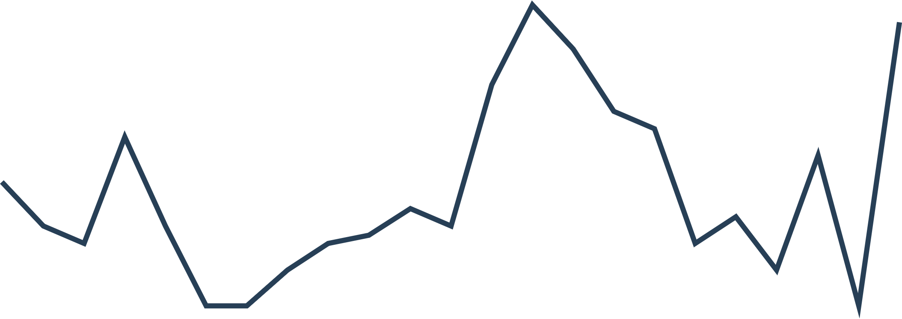
Doctoral theses
Total
803
Doctoral theses
Number of doctorates with mentors from the JSI
50
40
30
20
10
2000
2005
2010
2015
2020
The data are for the period 2000–2022, The data are the number of doctorates in the year with mentors from JSI

Slide 20

Awards
Total
122
awards
Number of Zois, Puh Awards and Ambassadors of Science
47
Zois prizes
5
Ambassadors of science
38
Zois awards
27
Puh
prizes
5
Puh
awards
Data are for the period 2000–2023

Slide 21
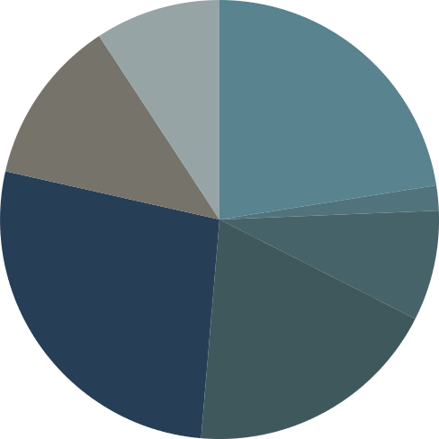
Planned revenue
Total
78.053
€ m of planned revenue
Planned revenues of the Institute by type of revenue for 2023
50.8 %
ARIS revenue
10.2 %
Foreign market
ARIS programme (JSI coordinator)
ARIS programme (JSI not coordinator)
ARIS young researchers
ARIS projects
22.5 %
1.8 %
7.9 %
18.5 %
12.1 %
SLO market
26.9 %
EU projects
ARIS – Slovenian Research and Innovation Agency
Data are for 2023

Slide 22
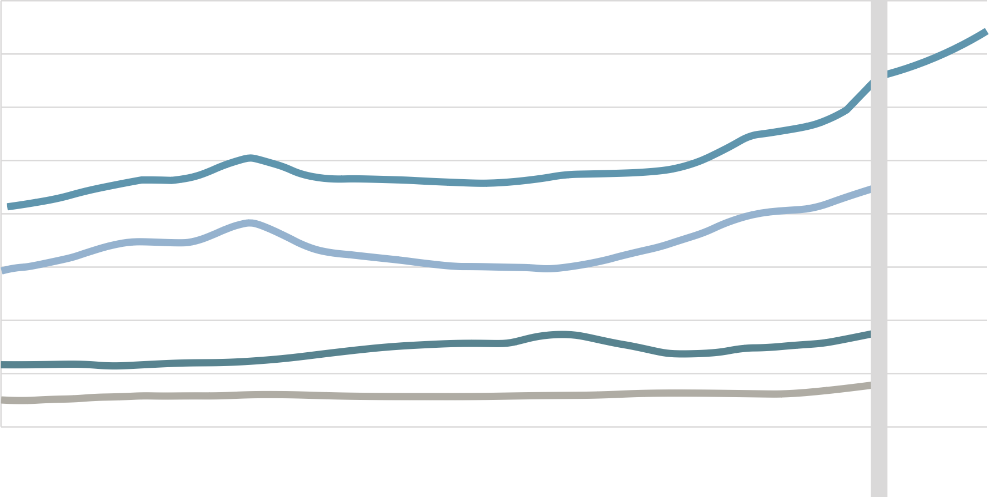
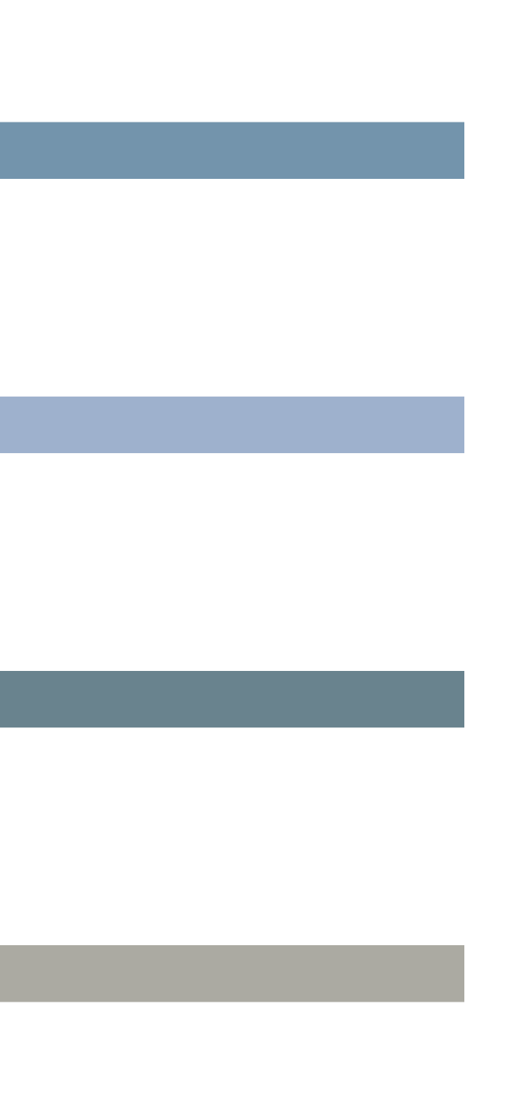
Revenue
Revenues of the Institute from 2007 to 2023
80
Total revenue
Public activities
Other activities
Other obligations
70
60
50
40
30
20
10
0
2007
2009
2011
2013
2015
2017
2019
2021
2023
the Financing Act was amended
The data are for the period 2007-2023. 2021 the Financing Act was amended.

Slide 23


Comparison with the rest of the world
“Jožef Stefan” Institute (IJS) // Max Planck Institute (MPS) // French National Centre for Scientific Research (CNRS)
 |  | population | Number of employees | Number of employees as % of population
IJS | Slovenia | 2.12 m | 1,200 | 0.05 %
MPS | Germany | 84.60 m | 23,950 | 0.03 %
CNRS | France | 64.83 m | 33,000 | 0.05 %
Employees
Le |  | Annual revenue | Annual income per employee
IJS | Slovenia | 65 € m | 54,200 €
MPS | Germany | 1,980 € m | 82,700 €
CNRS | France | 3,700 € m | 112,100 €
Revenue
Data are for 2022/2023

Slide 24
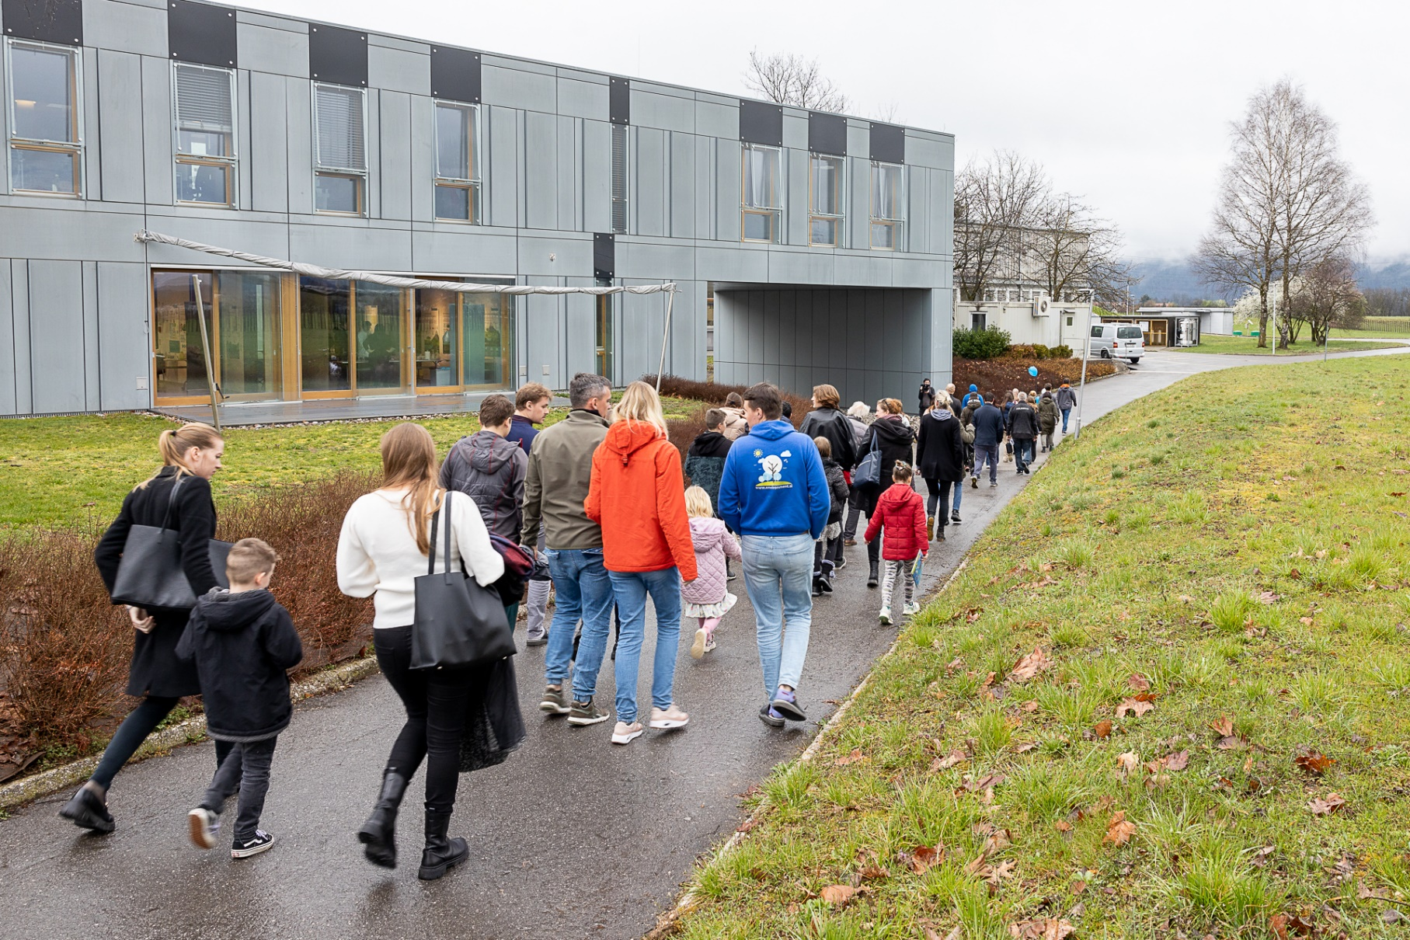
Public cooperation
Total of more than
20,600
visitors
Number of visitors to JSI events organised for different groups and number of visitors to the Nuclear Technology Training Centre
Events
1,100
9,300
1,100
650
2,000
350
Colloquia
Gallery
School visits
Days of Jožef Stefan
Open Day
Researchers' Night
Nuclear Technology Training Centre
6,180
For the year 2023

Slide 25
Appearances in the media
Total
2811
media releases
Incidences of the Jožef Stefan Institute and the
Director Prof. Dr. Boštjan Zalar appearing in print and online media
23 %
posts in
print media
Media that wrote the most on these topics:
Authors who wrote the most on these topics:
77 %
publications in online media
novice.najdi.si
sta.si
Delo
rtvslo.si
delo.si
STA
Saša Senica
Borut Hočevar
Sabina Petrov
M.K.
Specify for year 2023

Slide 26
Thank you for your attention
Jožef Stefan Institute
Jamova cesta 39
1000 Ljubljana
Slovenija
https://www.ijs.si/

